Slide 1
Implementation of Efficient Machine Learning Techniques for Prediction of Cardiac Disease
Meenakshi Mangaesh
Mary Liz
Athulya Rajeev
Asin Sona Thomas

Slide 2
CONTENTS
Dataset
Dataset Overview
Correlation Heatmap
Selected Features
Model Evaluation
Model Comparison

Slide 3
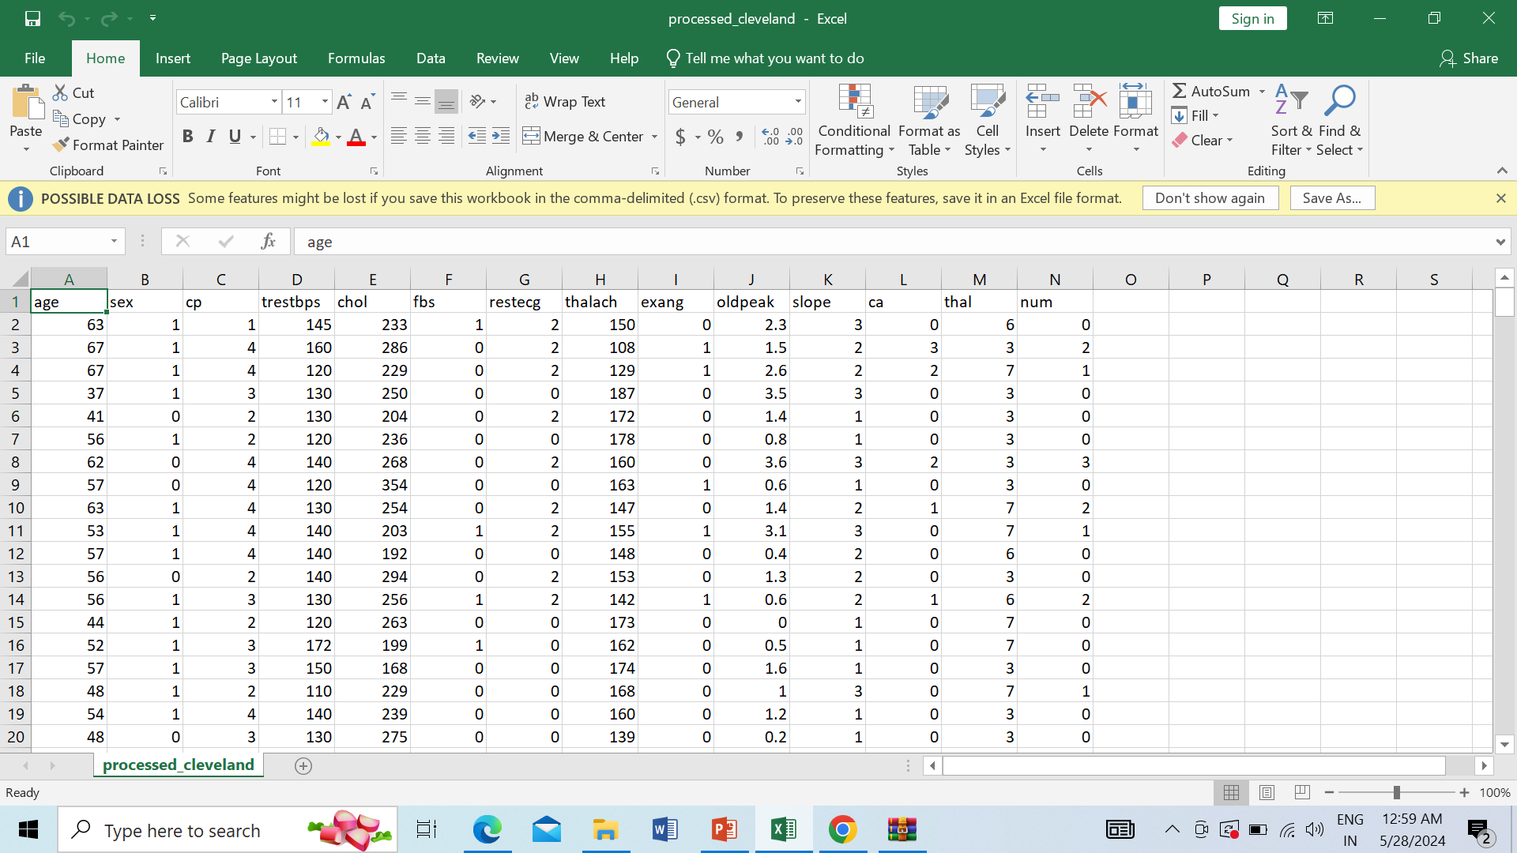
DATASET
Validated dataset from KAGGLE. It is a heart disease dataset called cleavland dataset from UCI Repository.

Slide 4
Dataset Overview
Consists of 4 databases: Cleveland, Hungary, Switzerland, Long Beach V.
Contains 13 attributes, including the predicted attribute.
Target Field
Refers to the presence of heart disease in the patient.
Integer values:
0 = No disease
1 = Disease

Slide 5
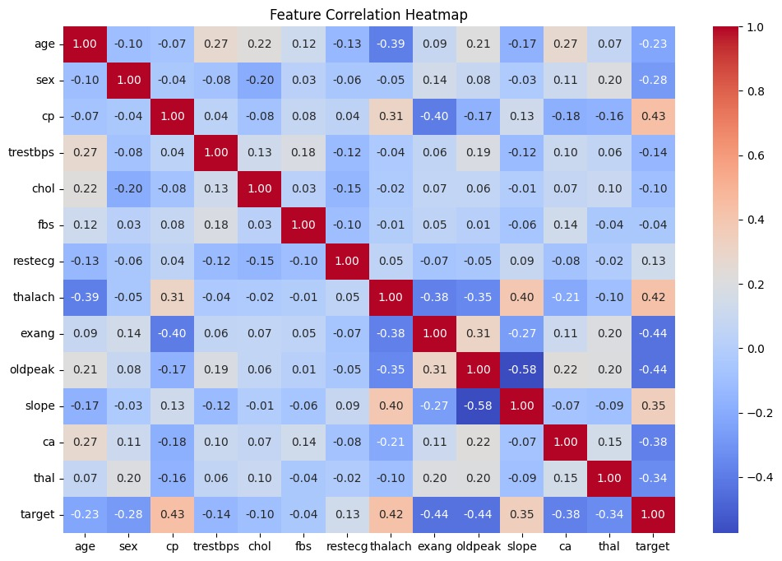
Correlation Matrix

Slide 6
Correlation - Details
Correlation with Target Variable:
target 1.000000
cp 0.434854
thalach 0.422895
slope 0.345512
restecg 0.134468
fbs -0.041164
chol -0.099966
trestbps -0.138772
age -0.229324
sex -0.279501
thal -0.337838
ca -0.382085
exang -0.438029
oldpeak -0.438441
🟦 - Selected features

Slide 7
Models Used
Random Forest
Support Vector macine
Logistic Regression

Slide 8
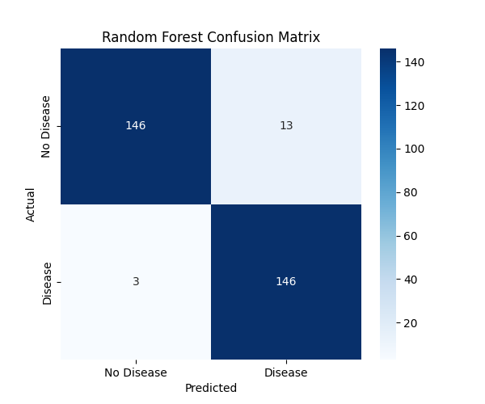
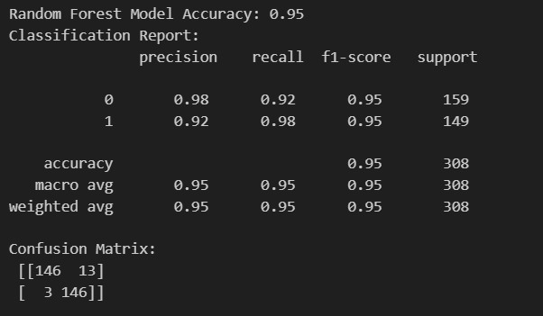
Evaluation Matrices – Random Forest

Slide 9
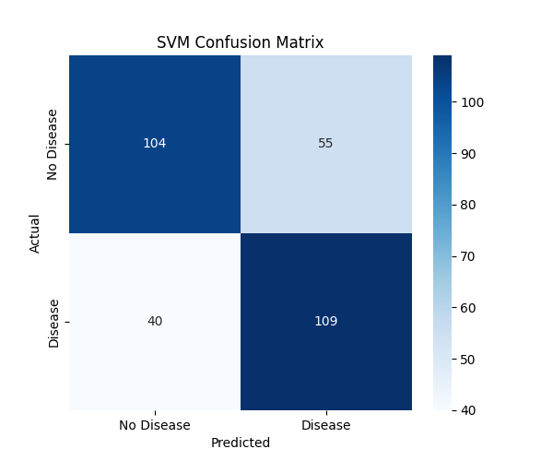
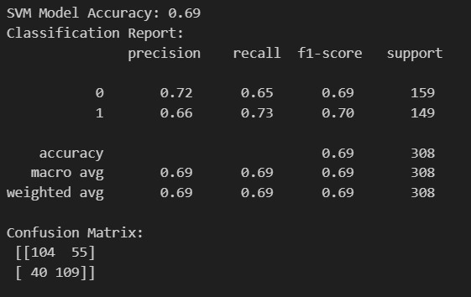
Evaluation Matrices – SVM

Slide 10
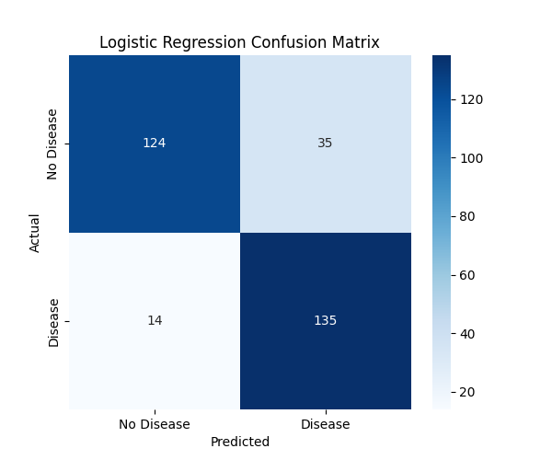

Evaluation Matrices – Logistic Regression

Slide 11
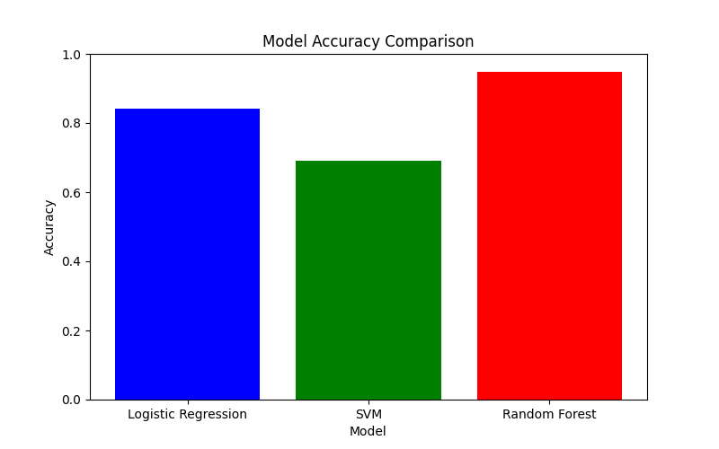
Models Comparison
Random Forest Model seems to have the highest accuracy (95%)

Slide 12
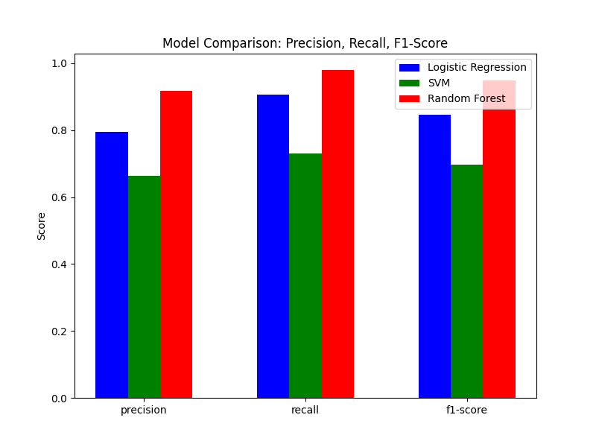
Evaluation Metrics Comparison

Slide 13
THANK YOU

